Slide 1
Rolling Horizon Evolutionary Algorithms IGGI Game Design II
Simon Lucas, Jialin Liu and Diego Perez
Game AI Research Group
Queen Mary University of London
Notes:
Hi, I’m Simon Lucas, welcome to my short video about general AI with statistical forward planning algorithms

Slide 2
Outline
The basic idea of Rolling Horizon Evolutionary Algorithms
A particular setup and parameterization
Implementation in a Game Playing Agent
Optimising performance

Slide 3
RHEA: Type of Statistical Simulation based AI
Relies on fast forward model:
Aim to run this around 2,000 ticks per decision
F(s,a)-> s’

Slide 4
Planet Wars – a Simple RTS (Real Time Strategy Game)

Slide 5
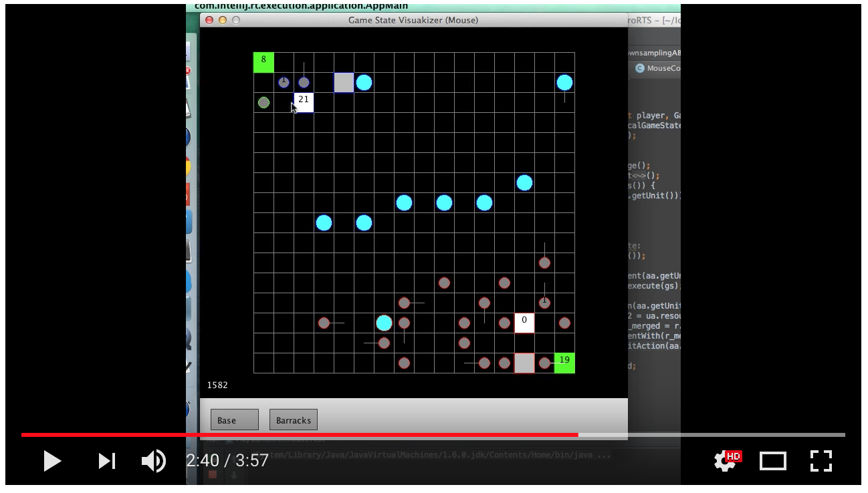
microRTS (CIG 2018) – another excellent challenge – branching factor of around 50,000 (CMABs look good for this)

Slide 6
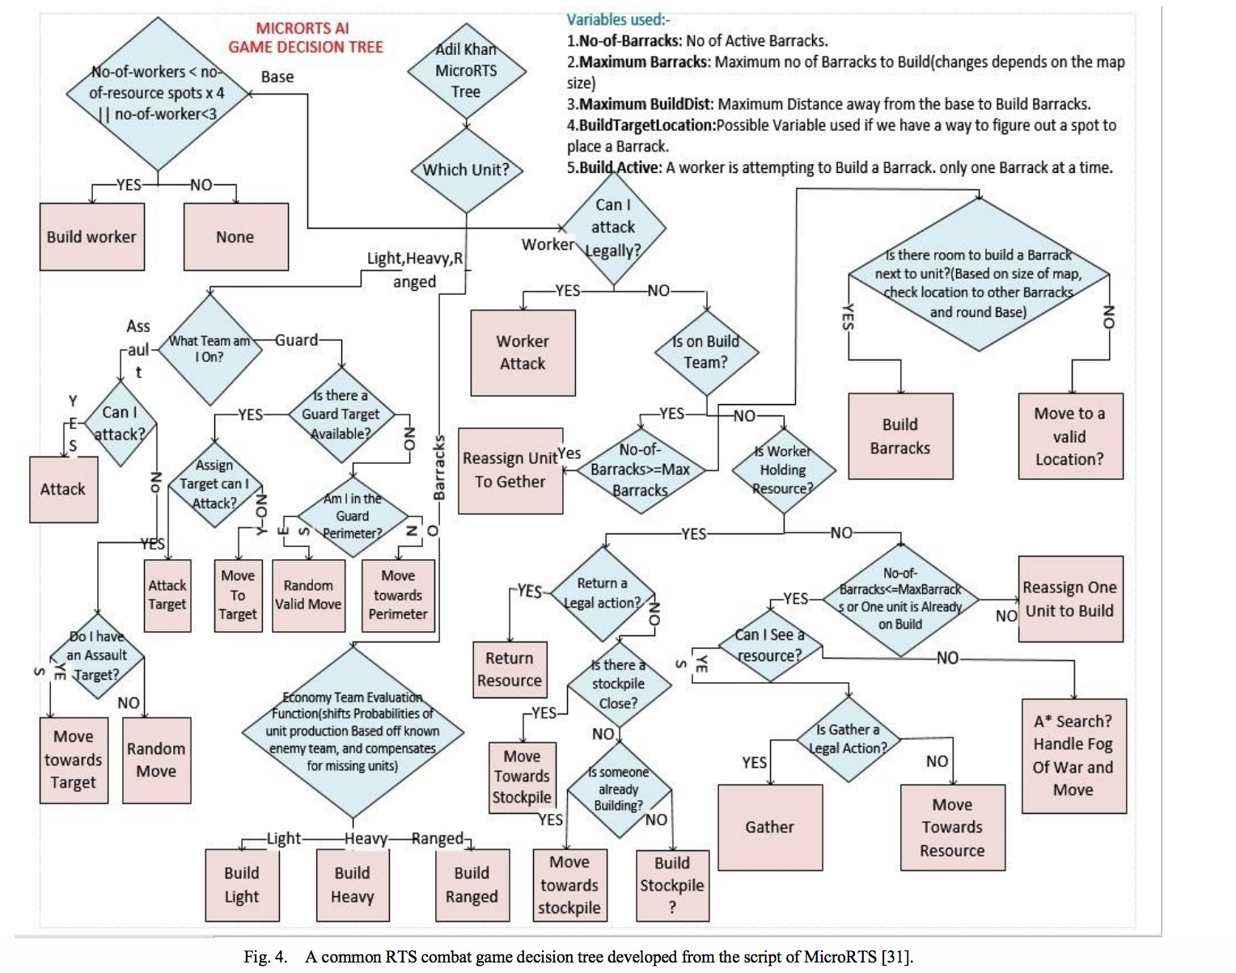
Best approach? Hand-coded versus Evo / Deep RL / ?

Slide 7
What you need to implement: (repeated from intro)
public interface AbstractGameState { AbstractGameState copy(); AbstractGameState next(int[] actions); int nActions(); double getScore(); boolean isTerminal(); }
Notes:
Here’s what you need to do to add this magic AI to your game or system: the ones to be careful with are copy and next

Slide 8
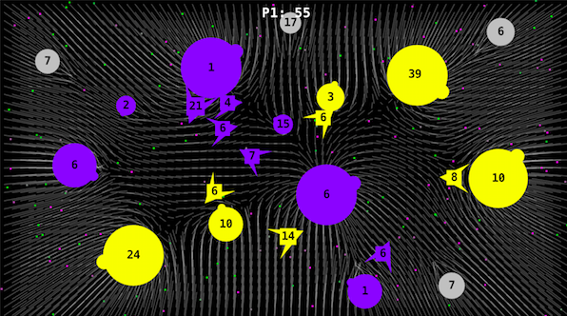
Copy state (20), copy-mutate seq(20), run (20 x 100), score (20), play, shift, repeat
93 [2, 17, 1, 11, 7, 5, 14, 8, 2, 12, 16, 1, 15, 7, 2, 3, 13, 2, 2, 10, 2, 12, 17, 2, 13, 11, 4, 13, 16, 13, 11, 17, 9, 7, 3, 9, 15, 7, 3, 11, 15, 10, 2, 11, 15, 4, 11, 15, 13, 13, 15, 13, 12, 9, 4, 17, 11, 4, 8, 16, 17, 0, 7, 17, 16, 7, 8, 16, 9, 16, 5, 14, 2, 5, 14, 16, 5, 14, 8, 6, 1, 14, 9, 13, 17, 13, 0, 17, 0, 2, 16, 6, 8, 16, 7, 7, 1, 2, 15, 5, 0, 0, 4, 10, 5, 8, 11, 3, 13, 15, 2, 13, 5, 9, 3, 0, 5, 15, 13, 3, 6, 15, 11, 12, 16, 10, 8, 12, 15, 17, 14, 2, 7, 5, 8, 2, 10, 5, 4, 13, 14, 1, 2, 1, 15, 4, 7, 3, 15, 15, 16, 3, 11, 12, 4, 11, 2, 17, 15, 9, 1, 0, 9, 15, 16, 8, 4, 12, 7, 16, 11, 6, 4, 8, 10, 4, 7, 17, 17, 9, 5, 10, 16, 11, 4, 8, 7, 1, 1, 13, 5, 4, 12, 15, 8, 13, 13, 13, 13, 13]
eval
copy
472 [2, 17, 1, 11, 7, 5, 14, 8, 2, 12, 15, 1, 15, 7, 2, 3, 13, 2, 2, 10, 2, 12, 17, 2, 13, 11, 4, 13, 16, 13, 11, 17, 9, 7, 3, 9, 15, 7, 3, 11, 15, 10, 2, 11, 15, 4, 11, 15, 13, 13, 15, 13, 12, 9, 4, 17, 11, 4, 8, 16, 17, 0, 7, 17, 16, 7, 8, 16, 9, 16, 5, 14, 2, 5, 14, 16, 5, 14, 8, 6, 15, 14, 9, 13, 17, 13, 0, 17, 0, 2, 16, 6, 8, 16, 7, 7, 1, 2, 15, 5, 0, 0, 4, 10, 5, 8, 11, 3, 13, 15, 2, 13, 5, 9, 3, 5, 5, 15, 13, 3, 6, 15, 11, 12, 16, 10, 3, 12, 15, 17, 14, 2, 7, 5, 8, 2, 10, 5, 4, 13, 14, 1, 2, 1, 15, 4, 7, 3, 15, 15, 16, 3, 11, 7, 4, 11, 2, 17, 15, 9, 1, 0, 9, 15, 16, 8, 4, 12, 7, 16, 11, 6, 4, 8, 10, 4, 7, 17, 17, 9, 5, 10, 16, 11, 4, 8, 7, 1, 1, 13, 5, 4, 12, 15, 8, 13, 13, 13, 13, 13]
eval
copy

Slide 9
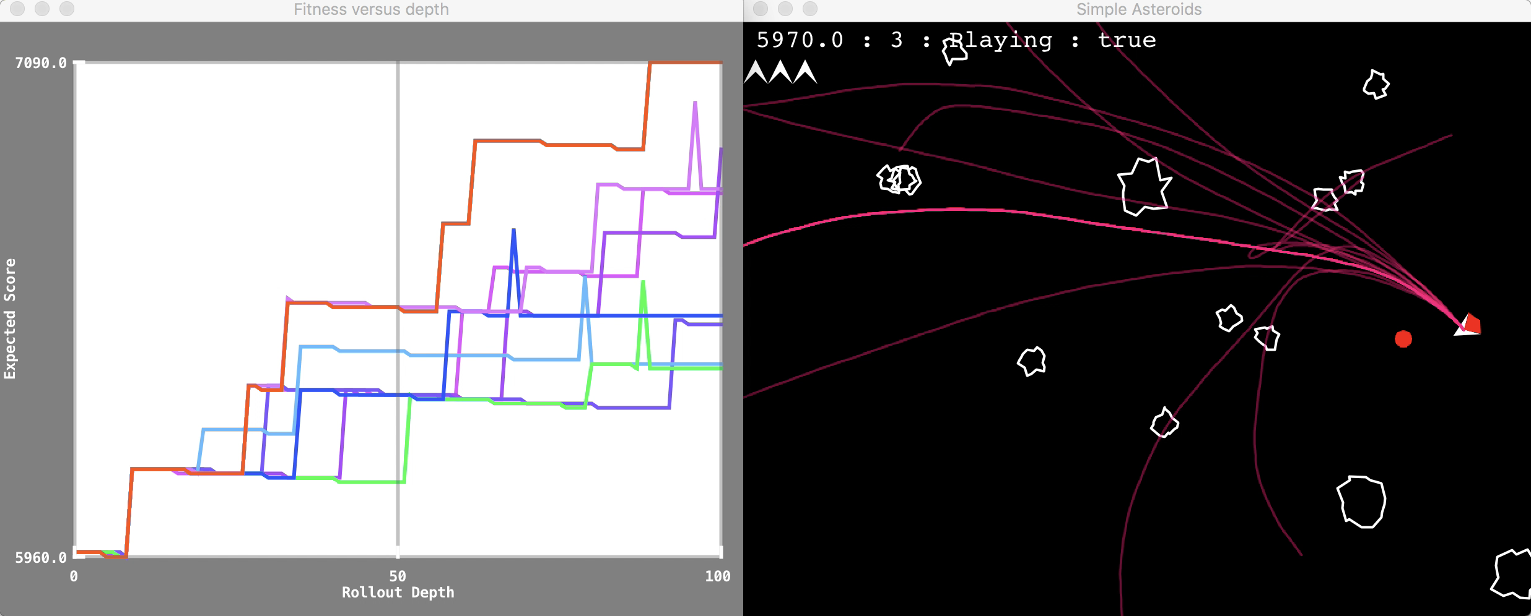
Rolling Horizon Evolution in Asteroids (each number corresponds to a joystick action)

Slide 10
Copy state (20), copy-mutate seq(20), run (20 x 100), score (20), play, shift, repeat
93 [2, 17, 1, 11, 7, 5, 14, 8, 2, 12, 16, 1, 15, 7, 2, 3, 13, 2, 2, 10, 2, 12, 17, 2, 13, 11, 4, 13, 16, 13, 11, 17, 9, 7, 3, 9, 15, 7, 3, 11, 15, 10, 2, 11, 15, 4, 11, 15, 13, 13, 15, 13, 12, 9, 4, 17, 11, 4, 8, 16, 17, 0, 7, 17, 16, 7, 8, 16, 9, 16, 5, 14, 2, 5, 14, 16, 5, 14, 8, 6, 1, 14, 9, 13, 17, 13, 0, 17, 0, 2, 16, 6, 8, 16, 7, 7, 1, 2, 15, 5, 0, 0, 4, 10, 5, 8, 11, 3, 13, 15, 2, 13, 5, 9, 3, 0, 5, 15, 13, 3, 6, 15, 11, 12, 16, 10, 8, 12, 15, 17, 14, 2, 7, 5, 8, 2, 10, 5, 4, 13, 14, 1, 2, 1, 15, 4, 7, 3, 15, 15, 16, 3, 11, 12, 4, 11, 2, 17, 15, 9, 1, 0, 9, 15, 16, 8, 4, 12, 7, 16, 11, 6, 4, 8, 10, 4, 7, 17, 17, 9, 5, 10, 16, 11, 4, 8, 7, 1, 1, 13, 5, 4, 12, 15, 8, 13, 13, 13, 13, 13]
eval
copy
472 [2, 17, 1, 11, 7, 5, 14, 8, 2, 12, 15, 1, 15, 7, 2, 3, 13, 2, 2, 10, 2, 12, 17, 2, 13, 11, 4, 13, 16, 13, 11, 17, 9, 7, 3, 9, 15, 7, 3, 11, 15, 10, 2, 11, 15, 4, 11, 15, 13, 13, 15, 13, 12, 9, 4, 17, 11, 4, 8, 16, 17, 0, 7, 17, 16, 7, 8, 16, 9, 16, 5, 14, 2, 5, 14, 16, 5, 14, 8, 6, 15, 14, 9, 13, 17, 13, 0, 17, 0, 2, 16, 6, 8, 16, 7, 7, 1, 2, 15, 5, 0, 0, 4, 10, 5, 8, 11, 3, 13, 15, 2, 13, 5, 9, 3, 5, 5, 15, 13, 3, 6, 15, 11, 12, 16, 10, 3, 12, 15, 17, 14, 2, 7, 5, 8, 2, 10, 5, 4, 13, 14, 1, 2, 1, 15, 4, 7, 3, 15, 15, 16, 3, 11, 7, 4, 11, 2, 17, 15, 9, 1, 0, 9, 15, 16, 8, 4, 12, 7, 16, 11, 6, 4, 8, 10, 4, 7, 17, 17, 9, 5, 10, 16, 11, 4, 8, 7, 1, 1, 13, 5, 4, 12, 15, 8, 13, 13, 13, 13, 13]
eval
copy

Slide 11
Rolling Horizon Evolution in Asteroids (each number corresponds to a joystick action)

Slide 12
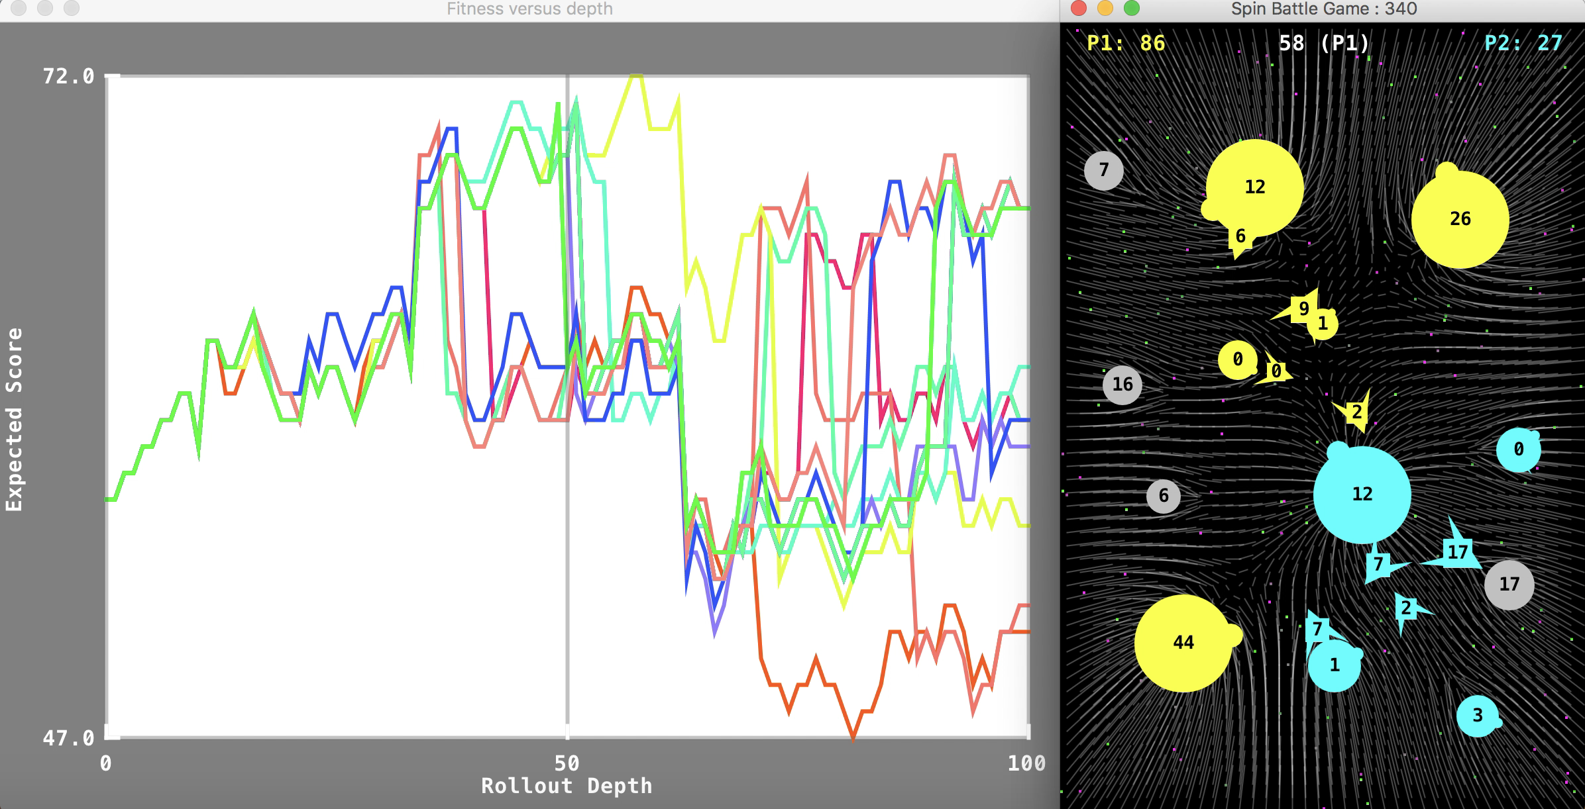
Rolling Horizon Evolution in Planet Wars (each number-pair specifies source and target planets for fleet transits)

Slide 13
Further references
Rolling horizon evolution versus tree search for navigation in single-player real-time games, D Perez, S Samothrakis, S Lucas, P Rohlfshagen, Proceedings of the 15th annual conference on Genetic and evolutionary computation (GECCO)
Rolling horizon methods for games with continuous states and actions, S Samothrakis, SA Roberts, D Perez, SM Lucas, 2014 IEEE Conference on Computational Intelligence and Games (CIG), 1-8
Analysis of vanilla rolling horizon evolution parameters in general video game playing, RD Gaina, J Liu, SM Lucas, D Pérez-Liébana, European Conference on the Applications of Evolutionary Computation, 418-434
Rolling horizon evolution enhancements in general video game playing, RD Gaina, SM Lucas, D Perez-Liebana, Computational Intelligence and Games (CIG), 2017 IEEE Conference on, 88-95
See our Google Scholar Profiles for more

